Slide 1
Blood Transfusion Safety update for Primary Care
Barrie Ferguson
2021

Slide 2
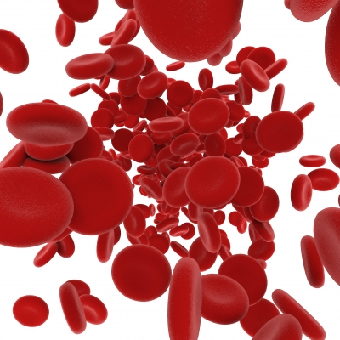
Introduction
Blood Transfusion in the UK is generally very safe, but not without risk
The most common preventable risk relates to errors in identifying patients correctly
Blood is donated to us and we must ensure we use it safely and appropriately. Though donated, it costs the hospital £145 per unit to buy from NHS Blood and Transplant.

Slide 3

Haemovigilance and Serious Hazards of Transfusion
Serious Hazards of Transfusion (SHOT) was formed in 1996
National voluntary reporting system recording adverse reactions and events
It identifies risks, problems and produces recommendations to improve patient safety

Slide 4
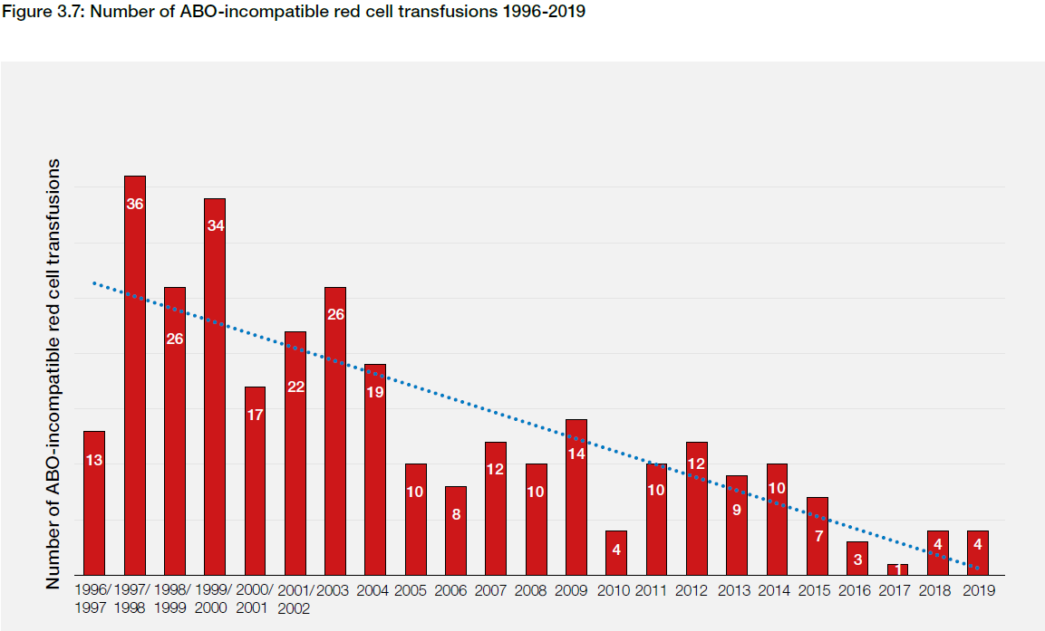
Impact of blood safety and haemovigilance
Requirement for training and competency assessment
Since SHOT established, alongside other blood safety initiatives, there has been a steady decrease in the numbers of ABO incompatible transfusions in the NHS
Notes:
Reduction in ABO incompatible transfusion events is a direct result of SHOT – reporting, analysing the data and making recommendations

Slide 5
The decision to transfuse
Red cell use has declined by over 20 % in the last 20 years
There is increasing evidence that the use of restrictive transfusion thresholds improves patient morbidity and mortality
Patient Blood Management comprises a series of initiatives designed to help ensure appropriate transfusion for every patient

Slide 6
Patient Blood Management
Nationally agreed restrictive thresholds for transfusion
Improved surgical techniques
Pre operative anaemia management
Single unit transfusion policy in stable adult inpatients
Correction of cause of anaemia eg iron/B12 and Folate
Use of Cell salvage

Slide 7
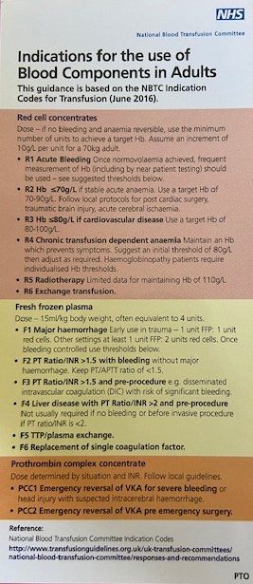
National restrictive thresholds for RBC Transfusion
National Indications include:
  stable acute anaemia, threshold of 70 g/litre and a target of 70–90 g/litre;
  acute coronary syndrome, threshold of 80 g/litre and a target of 80–100 g/litre
  chronic anaemia, maintain a haemoglobin that prevents symptoms, with a suggested initial threshold of 80g/l
  In patients with ischaemic stroke, traumatic brain injury, severe sepsis or undergoing radiotherapy a higher transfusion trigger may be beneficial

Slide 8
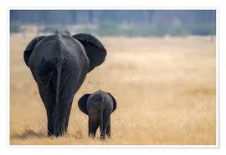
Size matters.......
The rule that 1 unit of blood increases Hb by 10 g/l holds for someone of 70 kg; in someone weighing 50 kg the Hb may rise by 15 to 20 g/l after 1 unit
It is very rare to need to transfuse to over 100 g/l

Slide 9
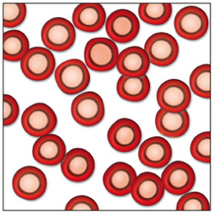
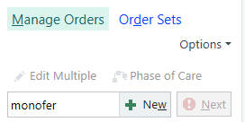
Haematinic deficiency: Iron deficiency
Chronic iron deficiency anaemia is not an indication for transfusion unless symptoms of end organ symptoms such as angina, claudication
Oral iron is first line treatment but if not tolerated or ineffective then IV iron can be given
1g monofer contains the same amount of iron as contained in 4 units RBC
Haemoglobin levels will start to improve in 7 to 14 days
Intravenous iron can be arranged in Sidmouth or Tiverton Community hospitals or via Wynard Ambulatory unit

Slide 10
Risks of Blood Transfusion

Slide 11
Risks of blood transfusion
Transfusion is very safe; the risk of dying from a transfusion is less than 1 in 100 000 and the risk of suffering major morbidity is less than 1:20 000
The most common cause of severe morbidity and mortality is Transfusion Associated Circulatory Overload (TACO) which is left ventricular failure within the 24 hours after transfusion
Notes:
NEED TO REVIEW WITH SHOT REPORT

Slide 12
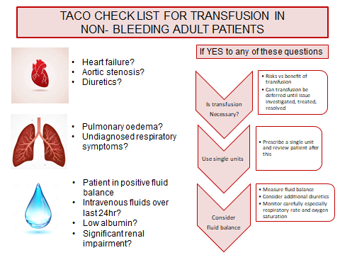
Transfusion Associated Circulatory Overload
(TACO)
When referring patients for day case transfusions at Wonford Sidmouth or Tiverton, consider the patient’s risk of TACO. The referral form will ask for relevant information.
SHOT recommend a beside check list of risks which will be assessed prior to transfusion.
If the patient is at risk the staff transfusing the patient will assess whether the transfusion is immediately necessary or whether the condition of the patient can be improved prior to transfusion, they will use single unit transfusion wherever possible, monitor the patient carefully and will consider use of diuretics during transfusion.

Slide 13
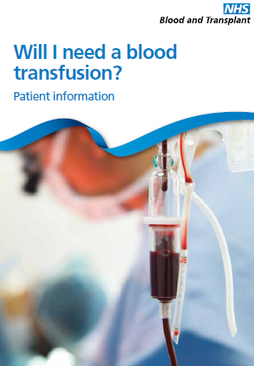
Patient Consent to Blood Transfusion
Written consent is not required for blood transfusion, but patients should have the risks, benefits and alternatives to transfusion explained to them if possible and recorded in the patient records
Provide written information to back up your discussion, for example this leaflet available on all wards
Importantly, patients need to be told that once transfused they will no longer be able to donate blood.

Slide 14
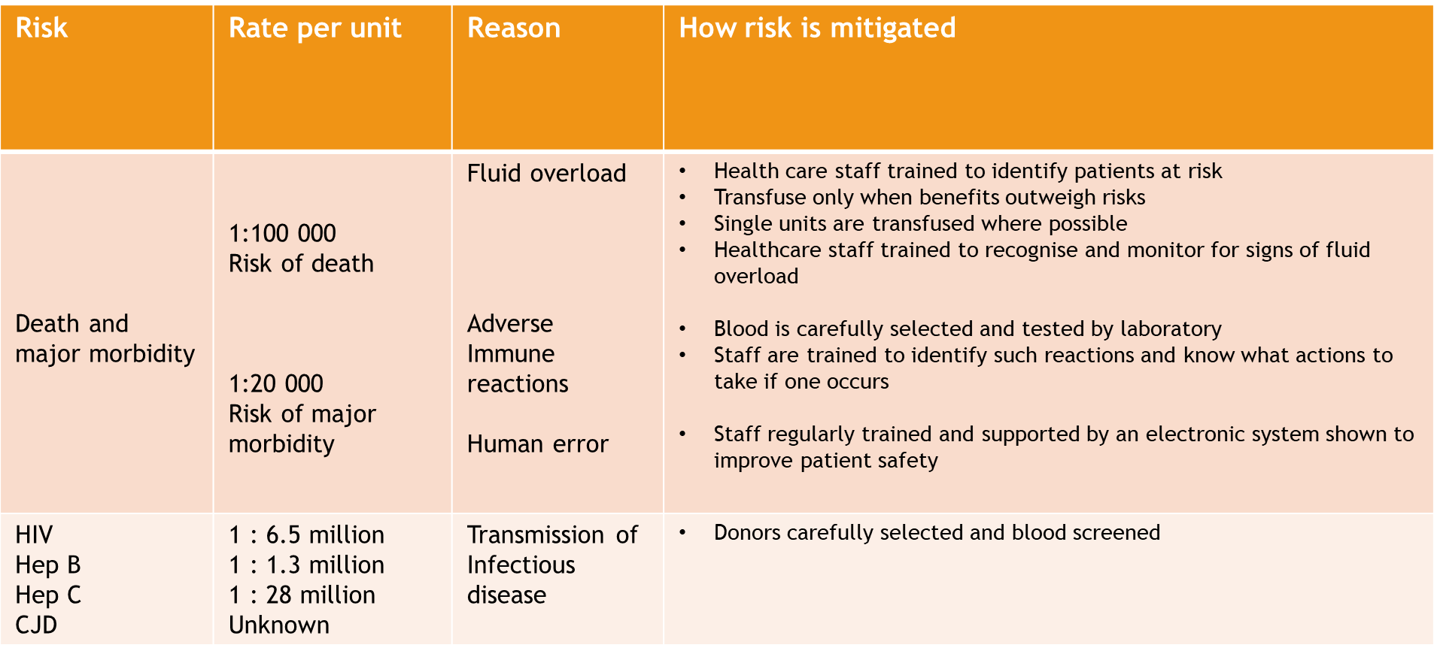
Consenting patients for transfusion

Slide 15
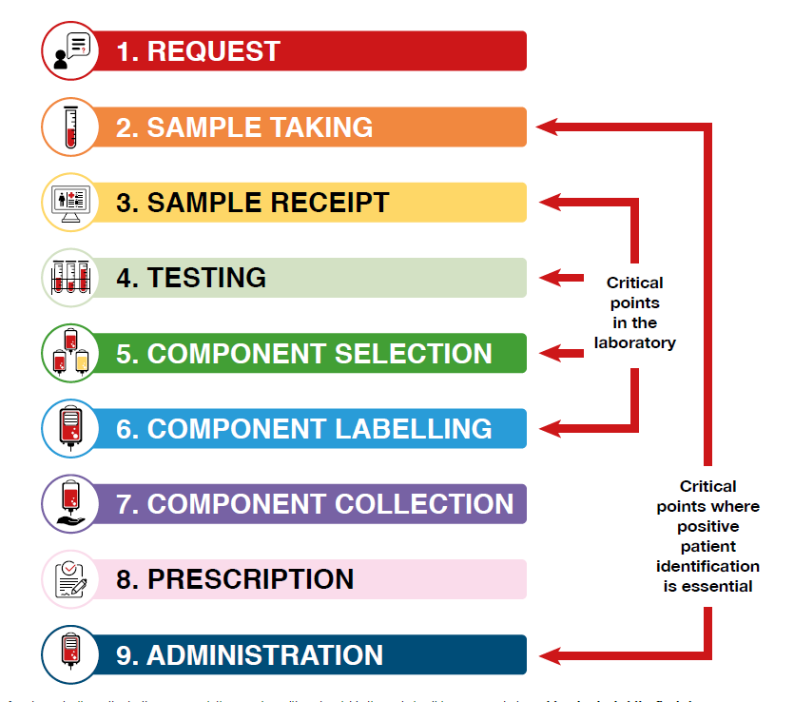
Requesting and labelling samples for transfusion
In the clinical area, there two critical points which can lead to ABO incompatible transfusions, one of these points is at sample taking
Every year we receive a number of samples where the blood in the sample is not the blood of the patient identified on the label

Slide 16
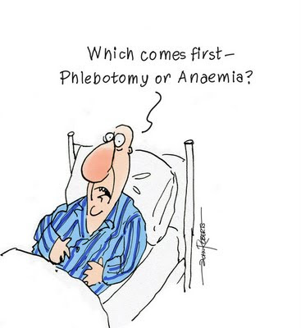
The two sample or group check policy
The transfusion laboratory needs confirmation of a patient’s ABO group from 2 separate samples to reduce the risk from these mislabelled samples
1 sample can be historic, 80% of patients have a previous group and save
If you are unsure whether you need to take one sample or two, please contact the transfusion laboratory
If you need to take 2 samples, you will need 2 request forms, to identify the patient twice and take 2 different samples which will be labelled at different times.

Slide 17
Sample labelling at GP practice/community
In GP surgeries or in patient’s homes, the sample label must always be hand written
If GP labels or hospital pre printed PAS labels are stuck onto the sample tube the sample will be rejected by the transfusion laboratory

Slide 18
How soon before transfusion can the sample be taken
The sample needs to be taken within 72 hours of transfusion
In chronically transfused haematology patients, if this tight timeline is difficult, an extension to 7 day validity can be requested in discussion with the patient’s consultant

Slide 19
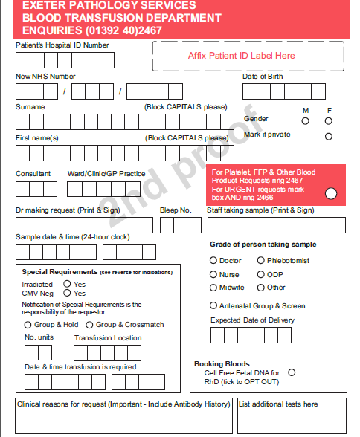
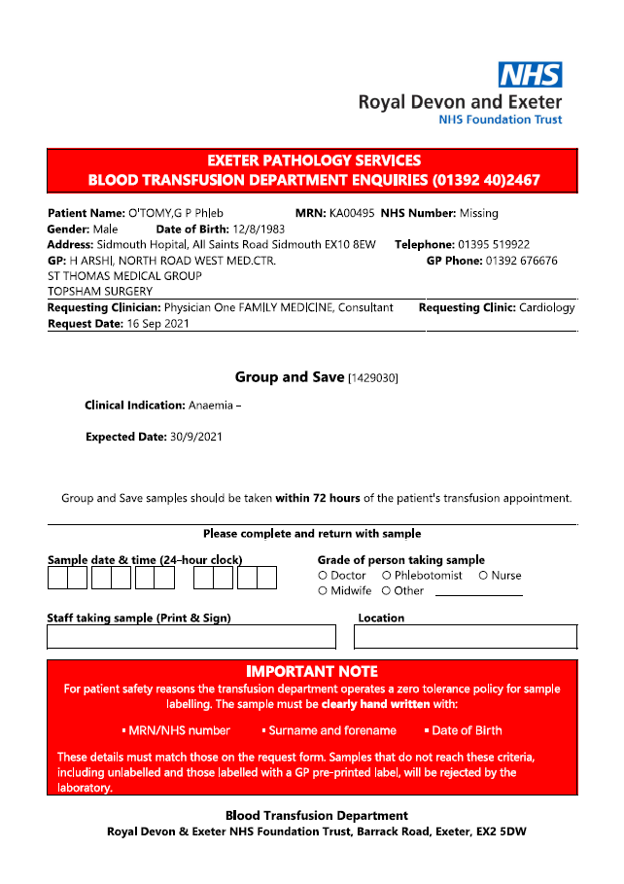
There are now 2 request forms
GP Request
Secondary Care request
Either form will be accepted by the laboratory

Slide 20
How to complete GP request form
Use patient sticker or handwrite:
  Hospital or NHS number
  Surname
  Fore name
  Date of birth
Please add requesting DR name, so that we know who to contact
Complete special requirements
  (listed on back of form)
Group and save or cross match and number of units, when and where transfusion will take place
Meaningful reason for transfusion
Notes:
20
May use PAS label on form only.
Remember SBAR
Most samples come in either low Hb or bleeding.
Must tick yes/no in the irradiated.
WE USE MONOVETTE sample tubes.
20

Slide 21
How to complete secondary care request form
Fill in Sample date & time, staff taking sample and location fields on request form.

Slide 22
Sample labelling at GP practice/community
In GP surgeries or in patient’s homes, the sample label must always be hand written
If GP labels or hospital pre printed GP patient labels or hospital PAS labels are stuck onto the sample tube the sample will be rejected by the transfusion laboratory

Slide 23
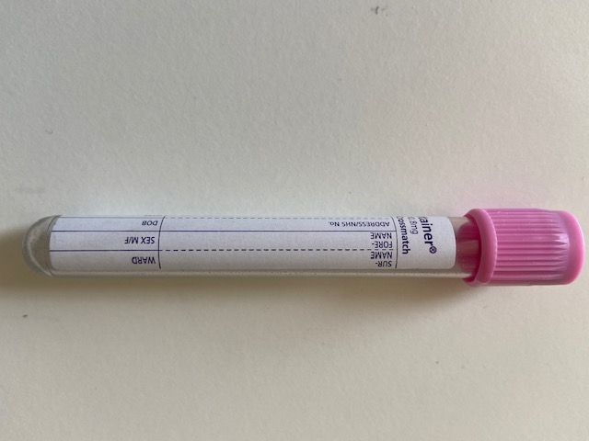
Handwritten labels for transfusion must include:
Patient ID details must exactly match those on request form
Patient first name
Patient surname
Patient date of birth
Patient hospital number or NHS number (the same one as on the request form or either if both on request form)
Sample taker signature
Date and time

Slide 24
Timeline for requests for community or day case transfusion
Day 1 Sample taken, community samples typically arrive in the laboratory at about 4 - 5pm
Day 2 Blood cross matched in laboratory
Day 3 Transfusion

Slide 25
TAKE HOMES
Use restrictive RBC thresholds and the single unit policy where possible so that each transfusion is appropriate
In haematinic deficiency, replace what is missing and use transfusion only when required for end organ symptoms
When referring patients for day case transfusions consider risk of transfusion associated circulatory overload
Take care when sample taking, always positively identify your patients.

