Slide 1
Blood Transfusion Sampling for healthcare staff working in community settings
The Hospital Transfusion Team 2021
rde-tr.HTT@nhs.net

Slide 2
Introduction
Transfusion of blood, whilst reactively safe in the UK, is not without risk and the most common preventable risk relates to errors in identifying patients correctly.
There are national regulations and guidelines that the transfusion laboratory has to comply with to enable it to continue to issue blood.
These slides will help healthcare staff in community settings request and label samples for transfusion.

Slide 3

ABO Blood Groups
There are four main groups:
  A, B, AB and O.
The groups are named after the antigens on the outside of the RBC.
  Group B has B antigens on their RBC
  Group A has A antigens on their RBC
  Group AB have both A and B on their RBC
  Group O have no antigens on the outside of their RBC
Group B
Notes:
Barrie to send some slides is this the best way for staff to understand this especially as some non registered staff
tWill, can this be interactive? can the staff view the blank table first and put in their answers and then overlay the answers to check they are correct?

Slide 4
ABO INCOMPATIBLE TRANSFUSION
If Group A blood is given to someone who is Group B for example, an acute transfusion reaction will occur. This may lead to collapse and death.
ABO incompatible transfusions are an NHS ‘Never Event’ meaning they are completely avoidable and yet if they do occur they cause significant harm and so they should ‘never’ happen.
Most of the training you receive and the safety drive within transfusion is to avoid ABO incompatible transfusion.
‘Right Patient, Right Blood’

Slide 5
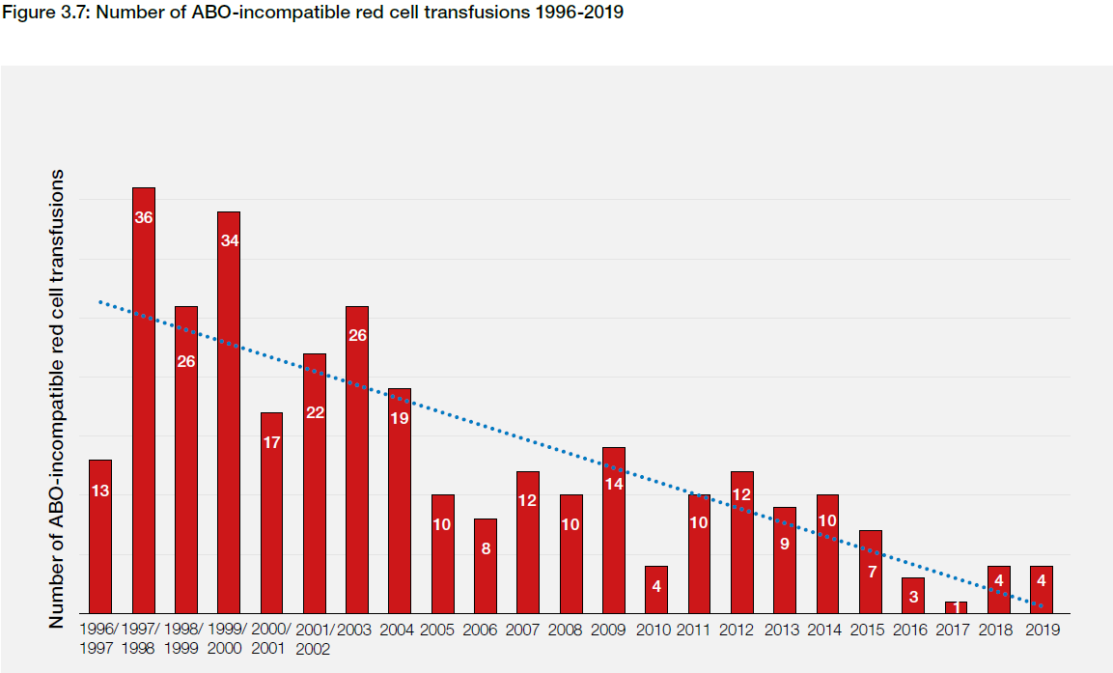
Training and other safety initiatives have reduced the numbers of ABO incompatible transfusions in the NHS
Requirement for training and competency assessment
Notes:
Reduction in ABO incompatible transfusion events is a direct result of SHOT – reporting, analysing the data and making recommendations

Slide 6
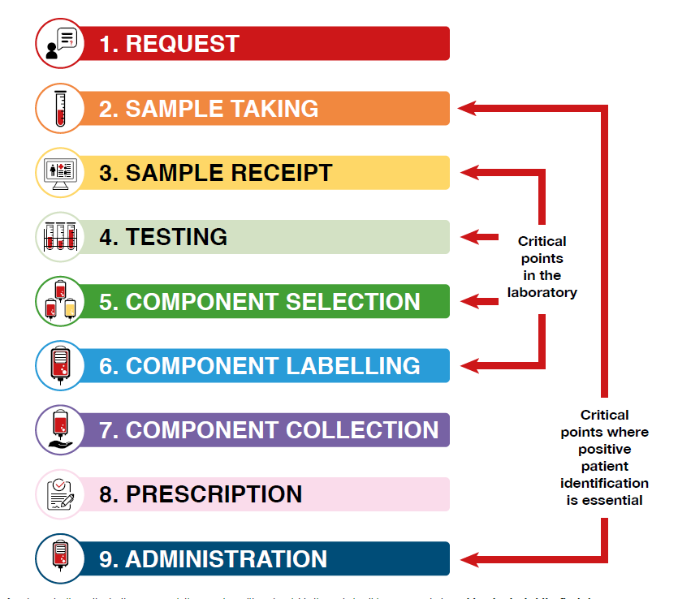
Right Blood Right Patient
In the clinical area, there two critical points which can lead to ABO incompatible transfusions:
  Taking and labelling the sample
  Administering the blood unit

Slide 7
How do we ensure the patient gets the right blood?
All staff involved in transfusion are accountable for safe practice and must be trained and competent in the transfusion procedures that they undertake.
Positive Patient Identification is crucial to ensure that the right blood is given to the right patient.
Always remember to ask your patient their name and date of birth before you take the blood sample.
Confirm that these match exactly those on the request form.
Notes:
I added a bit to the bottom paragraph alter as required

Slide 8
Sample labelling at GP practice/community
In GP surgeries or in patient’s homes, the sample label must always be hand written
If GP labels or hospital pre printed PAS labels are stuck onto the sample tube the sample will be rejected by the transfusion laboratory

Slide 9
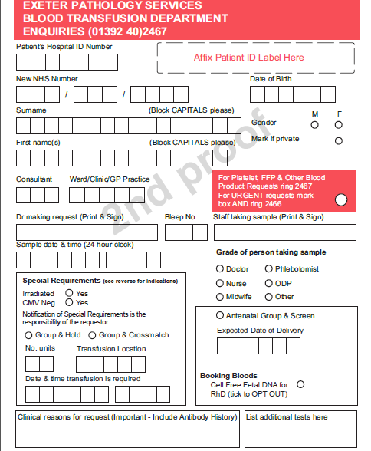
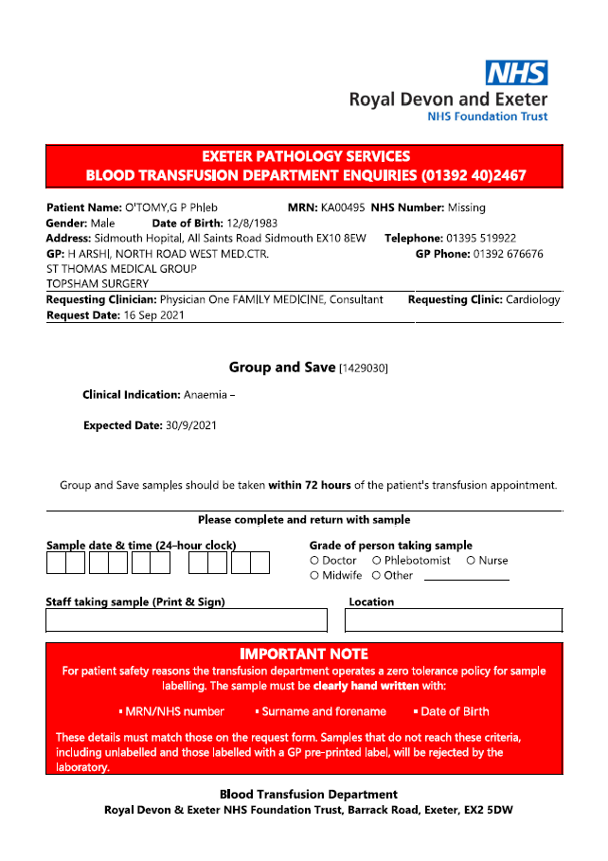
Request forms
Either form will be accepted by the laboratory
GP Request
Secondary Care request

Slide 10
How to complete GP request form
Use patient sticker or handwrite:
  Hospital or NHS number
  Surname
  Fore name
  Date of birth
Please add requesting DR name, so that we know who to contact
Complete special requirements
(listed on back of form)
Group and save or cross match and number of units, when and where transfusion will take place
Meaningful reason for transfusion not low Hb if possible…
Notes:
10
May use PAS label on form only.
Remember SBAR
Most samples come in either low Hb or bleeding.
Must tick yes/no in the irradiated.
WE USE MONOVETTE sample tubes.
10

Slide 11
How to complete secondary care request form
Handwrite the following information on the specimen bottle:
  Hospital or NHS number
  Surname
  Forename
  Date of birth
  Sign, date and time
Fill in Sample date & time, staff taking sample and location fields on request form.

Slide 12
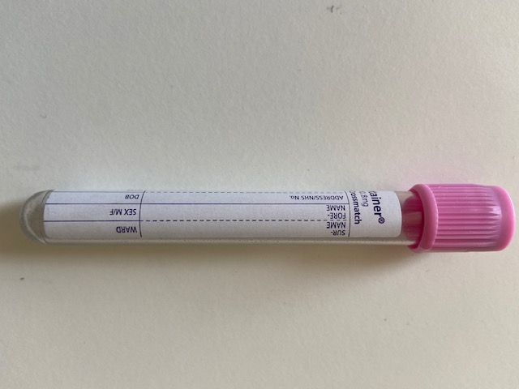
Handwritten labels for transfusion must include:
Patient ID details must exactly match those on request form
Patient first name
Patient surname
Patient date of birth
Patient hospital number or NHS number (the same one as on the request form or either if both on request form)
Sample taker signature
Date and time

Slide 13
Timeline for requests for community or day case transfusion
Day 1 Sample taken, community samples typically arrive in the laboratory at about 5pm
Day 2 Blood cross matched in laboratory
Day 3 Transfusion

Slide 14
Thank you!
Any queries please:
Phone the transfusion laboratory on 01392 402466/7
OR
Email the hospital transfusion team on rde-tr.HTT@nhs.net
OR
Contact the community phlebotomy service on
01395 519922 (08:00 to 16:00)

